Slide 1
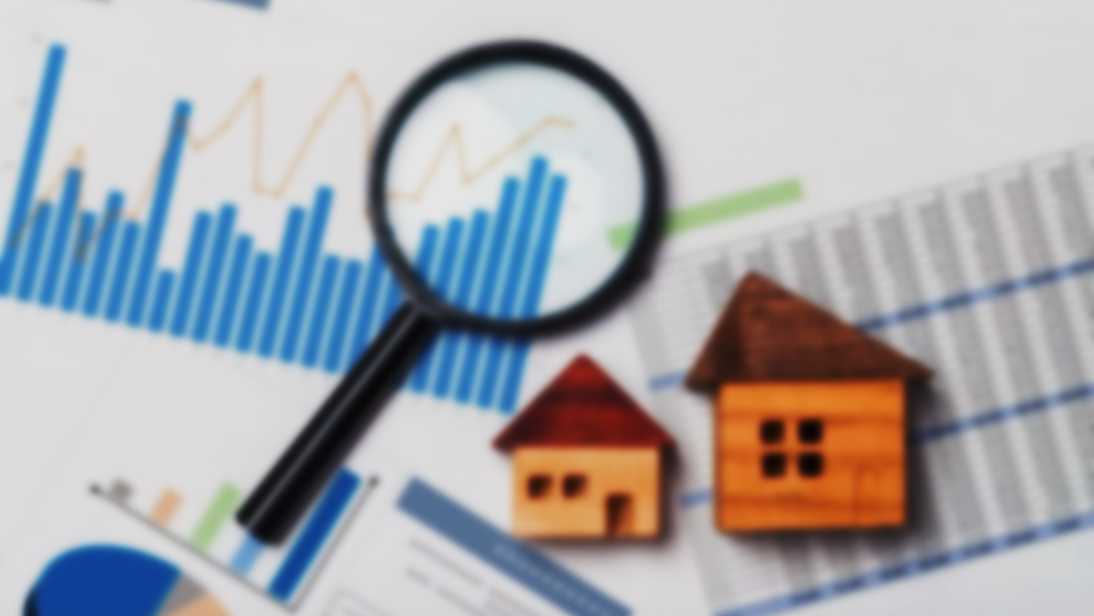

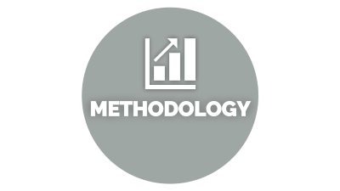





HOUSE PRICE PREDICTION
Notes:
https://unsplash.com/photos/AXu2aZ3YgP8

Slide 2

INTRODUCTION

Slide 3
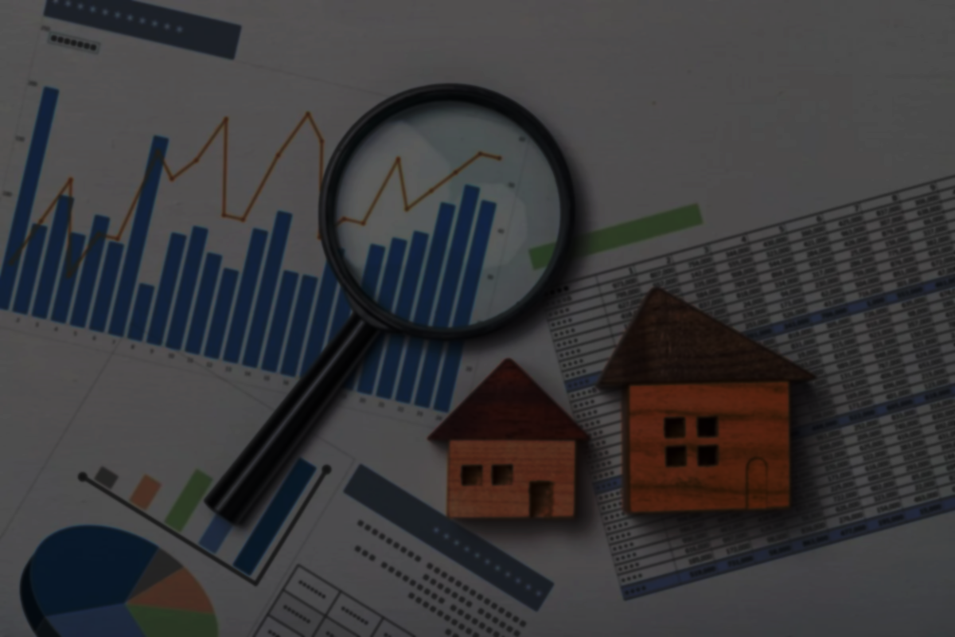
INTRODUCTION
Problem statement: - To predict a price for a home using the technology of machine learning.
Factors depending on Buying a house:-
Total Area
Locality or location
No. of Rooms
No. of Bathrooms
In this project, We are predicting the price of the house using ML by taking some of the factors.
Notes:
https://unsplash.com/photos/fItRJ7AHak8

Slide 4

METHODOLOGY

Slide 5
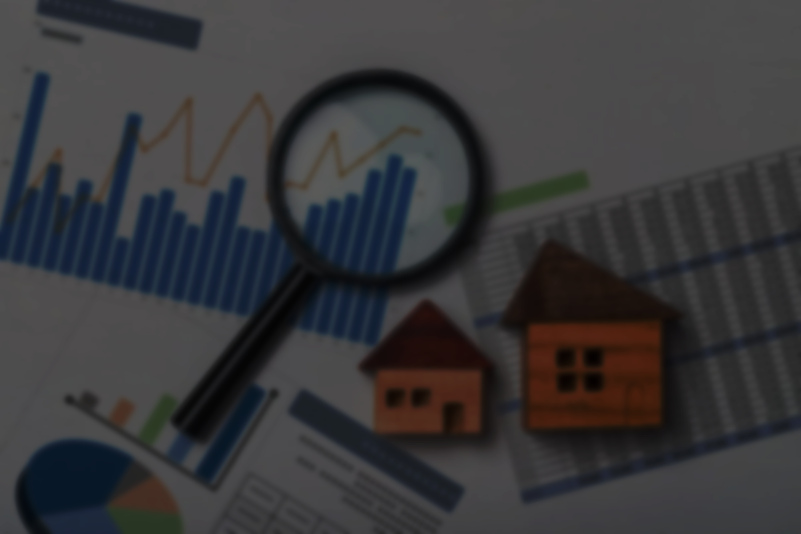
METHODOLOGY
SUPERVISED METHOD OF MACHINE LEARNING:- In this type of learning is based on the labeled datasets with the previous results to predict future outcomes.
Data Loading: - I load my data of the CSV file into the python program with the help of the pandas read_csv() function to work on that dataset with the help of python libraries.
Data Cleaning: - From that big dataset I have removed the null value data to work on a good dataset only with the help of dropna() function.
Feature Engineering: - Feature engineering means adding some new features to your dataset to find some patterns and then working on that data.
Outliner Removal: - It is a process in which the data having average cases are kept and the rare cases are removed from the datasets.
a) Using Business Logic: - In this, I take a piece of knowledge from the internet that there are some criteria that the room should have a minimum area of approx. 285 sq. ft., so less than that area rooms are removed from data sets.
b) Using Standard Deviation and Mean: - In this, I find the mean and std. deviation of price_per_sqft and then locations having properties having the cost of less BHK is higher than the more No. of BHK case, so removed that kind of dataset.
Notes:
https://unsplash.com/photos/48nerZQCHgo

Slide 6
METHODOLOGY

Slide 7
METHODOLOGY
c) Using Bathroom Feature: - According to the trend total no of bathrooms is less than and equal to BHK+2. So removed those outliners having more than bathrooms.
Dimensionality Reduction: - In this, I study the location stats, and then according to that I reduce the data sets by removing the data having less than 10 properties in a location.
6. Model Building: - In this now I check for the accuracy and regression for my dataset and after that final prediction function and testing of that function is done.
a) Linear Regression: - It is used to estimate real values (cost of houses, number of calls, total sales, etc.) based on a continuous variable(s). Here, we establish the relationship between independent and dependent variables by fitting the best line. This best-fit line is known as the regression line and is represented by a linear equation.
Y= a *X + b.
b) Prediction function: -Here I make the final segment of my code where we can predict the price for various localities, sizes, BHK, and no of the bathroom as an argument and get the approximate price for that house or home.
Notes:
https://unsplash.com/photos/48nerZQCHgo

Slide 8

DISCUSSION

Slide 9


DISCUSSION
By Using linear regression technique(Build Model)
Linear Regression is a machine learning algorithm based on supervised learning. It performs a regression task. Regression models a target prediction value based on independent variables. It is mostly used for finding out the relationship between variables and forecasting. Different regression models differ based on – the kind of relationship between dependent and independent variables they are considering, and the number of independent variables getting used. There are many names for a regression’s dependent variable. It may be called an outcome variable, criterion variable, endogenous variable, or regressand. The independent variables can be called exogenous variables, predictor variables, or regressors.
Linear regression is used in many different fields, including finance, economics, and psychology, to understand and predict the behaviour of a particular variable. For example, in finance, linear regression might be used to understand the relationship between a company’s stock price and its earnings, or to predict the future value of a currency based on its past performance.
Notes:
https://unsplash.com/photos/TvN54bnuQg8

Slide 10

CONCLUSION

Slide 11

CONCLUSION
As, now in the world of digitalization all the platforms are going online and converting into digital, so by this project in future, the traditional way of brokerage between the buyer and the seller can be covered and this kind of application can make purchasing and selling of the property more convenient and simple, as both of them can predict a price of their dream home by different criteria here you can make this vaster by adding
features like amenities near the property, kind of locality, reachability and transportation facilities and every smaller thing can be added and make more accurate and précised value for the home.
Notes:
https://unsplash.com/photos/GKLIsLZxhj0

